Slide 1
Managing Multiple Items

Slide 2

Objectives
After completing this lesson, you should be able to:
  Explain what a boolean expression is
  Create a simple if/else statement
  Describe the purpose of an array
  Declare and initialize a String or int array
  Access the elements of an array
  Explain the purpose of a for loop
  Iterate through a String array using a for loop
Notes:
Java SE8 Fundamentals 5 - <number>

Slide 3
Topics
  Working with conditions
  Working with an array of items
  Processing an array of items
Notes:
Java SE8 Fundamentals 5 - <number>

Slide 4

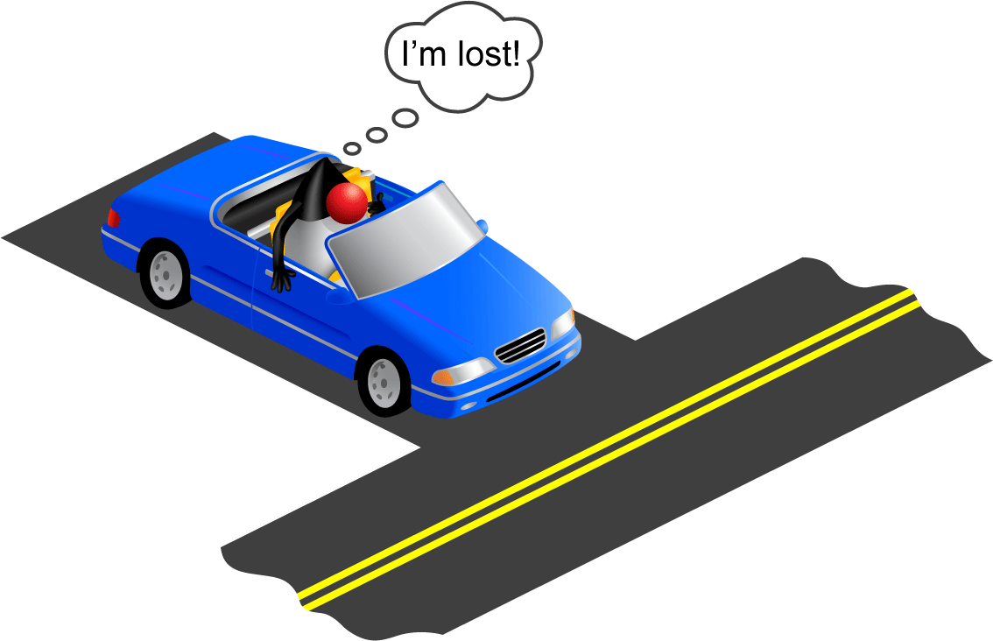
Making Decisions
Which way shall I go?
Notes:
In your daily life, you have to make a lot of decisions, and you often use the word “if” with some condition when making those decisions. For example, “If I can see my destination on the left, I will turn left, otherwise I’ll turn right.”
One of the tasks that programs often perform is to evaluate a condition and, depending on the result, execute different blocks or branches of code. This is called conditional logic, and it is handled through the use of an if/else statement.
Java SE8 Fundamentals 5 - <number>

Slide 5
The if/else Statement
boolean expression
    if ( <some condition is true> ) {
    // do something
    }
    else {
    // do something different
    }
if block
else block
Notes:
The if/else statement is one way of branching your code depending upon some condition. It uses the two Java keywords, if and else.
If some condition is true, execute the code within the if block.
Else, if that condition is false, execute the code in the else block.
The condition to be evaluated is surrounded by parentheses. It is referred to as a boolean expression because it must evaluate to either true or false.
Java SE8 Fundamentals 5 - <number>

Slide 6
Boolean Expressions
Review:
  boolean data type has only two possible values:
    true
    false
A boolean expression is a combination of variables, values, and operators that evaluate to true or false.
  length > 10;
  size <= maxSize;
  total == (cost * price);
Relational operators
Notes:
Remember that a boolean data type can have only two possible values: true and false.
In the same way, a boolean expression, made up of some combination of variables, values and operators, must also evaluate to either true or false.
This usually involves a special kind of operator called a relational operator. Several of these are used in the three examples above:
Greater than ( > )
Less than or equal to ( <= )
Equal to ( == ). In the example above, the result of cost * price is compared to the value of total. If they are equal, the entire expression evaluates to true.
Java SE8 Fundamentals 5 - <number>

Slide 7
Relational Operators
Condition | Operator | Example
Is equal to | == | int i=1; (i == 1)
Is not equal to | != | int i=2; (i != 1)
Is less than | < | int i=0; (i < 1)
Is less than or equal to | <= | int i=1; (i <= 1)
Is greater than | > | int i=2; (i > 1)
Is greater than or equal to | >= | int i=1; (i >= 1)
Notes:
Here you see a more complete list of relational operators. The table lists the different conditions you can test by using relational operators. The result of all relational operators is a boolean value. All of the examples in the table yield a boolean result of true.
Note: The equal sign (=) is used to make an assignment, whereas the == sign merely makes a comparison and returns a boolean.
Java SE8 Fundamentals 5 - <number>

Slide 8
Examples
  Sometimes there is a quicker way to meet your objective. boolean expressions can be used in many ways.
24 int attendees = 4;
25 boolean largeVenue;
26
27 // if statement example
28 if (attendees >= 5){
29 largeVenue = true;
30 }
31 else {
32 largeVenue = false;
33 }
34
35 // same outcome with less code
36 largeVenue = (attendees >= 5);
Assign a boolean by using an if statement.
Assign the boolean directly from the boolean expression.
Notes:
In the slide above, you see examples of two different ways to set the largeVenue boolean value:
In lines 28–33, an if statement tests the value of the attendees variable. If it is greater than 5, largeVenue is set to true; otherwise it is set to false.
In line 36, the same outcome is achieved with one line of code. The result of the same boolean expression that was evaluated in the if statement (attendees >=5) is directly assigned to the largeVenue boolean.
Java SE8 Fundamentals 5 - <number>

Slide 9

Exercise 5-1: Using if Statements
In this exercise, you use an if and an if/else statement:
  Declare a boolean, outOfStock.
  if quantity > 1
    Change the message variable to indicate plural
  if/else:
    if item is out of stock:
      Inform the user that the item is unavailable
    else
      Print the message
      Print the total cost
Notes:
Open the Java Code Console and access Lessons > 05-ConditionsArraysLoops > Exercise1.
Follow the instructions below the code editor to write two if statements in the main method.
Note: If you need help, the solution for this exercise can be found by clicking the Solution link.
Java SE8 Fundamentals 5 - <number>

Slide 10
Quiz
What is the purpose of the else block in an if/else statement?
  To contain the remainder of the code for a method
  To contain code that is executed when the expression in an if statement is false
  To test if an expression is false
Notes:
Answer: b
Java SE8 Fundamentals 5 - <number>

Slide 11
Topics
  Working with conditions
  Working with an array of items
  Processing an array of items
Notes:
Java SE8 Fundamentals 5 - <number>

Slide 12
What If There Are Multiple Items in the Shopping Cart?
01 // Without an array
02 String itemDesc1 = "Shirt";
03 String itemDesc2 = "Trousers";
04 String itemDesc3 = "Scarf";
05
06 // Using an array
07 String[] items = {"Shirt","Trousers","Scarf"};
Not realistic if 100s of items!
Much better!
Notes:
Think about how your code would look if there were multiple items in the shopping cart. You would have to initialize each item description separately. Imagine if you had a thousand items!
As you continued to build out this shopping cart application, the amount of code needed to handle each item individually would not only be time-consuming, but would make your code hard to read and difficult to maintain.
The code example above shows a better alternative that we will explore now: the array.
Java SE8 Fundamentals 5 - <number>

Slide 13
Introduction to Arrays
  An array is an indexed container that holds a set of values of a single type.
  Each item in an array is called an element.
  Each element is accessed by its numerical index.
  The index of the first element is 0 (zero).
    A four-element array has indices: 0, 1, 2, 3.
0 1 2 3
27
12
82
70
Notes:
The array is a container that holds a set of String values, or a set of int values, or a set of double values, and so on.
The elements (items) of the array are accessed through a numeric index. Using this index, you can set or get a value from a specific element.
Java SE8 Fundamentals 5 - <number>

Slide 14
Array Examples
Array of int types
27
12
82
70
54
1
30
34
Array of String types
Aaron Datires
Carrie DeKeys
Walter Mellon
Moe DeLawn
Hugh Mongus
Stan Ding
Albert Kerkie
Hugh Morris
Notes:
Arrays can be of any data type, but all elements have to share the same type.
Java SE8 Fundamentals 5 - <number>

Slide 15
Array Indices and Length
The ages array has eight elements.
First index
Element at index 5
0 1 2 3 4 5 6 7
0
Indices
27
12
82
70
54
1
1
30
34
Array length is 8.
(ages.length)
Notes:
An array is a container object that holds a fixed number of values of a single type. The length of an array is established when the array is created. After creation, the length of an array cannot be changed.
Each item in an array is called an element, and each element is accessed by its numerical index. As shown in the diagram above, index numbering begins with 0. For example, the eighth element would be accessed at index 7.
The length of an array can be accessed using dot notation to access the length field. Assuming that the array in the diagram is called ages, you can determine how many elements are in the array by using:
int agesLength = ages.length;
Java SE8 Fundamentals 5 - <number>

Slide 16
Declaring and Initializing an Array
  Syntax:
  type[] arrayIdentifier = {comma-separated list of values};
  Declare arrays of types String and int:
  String[] names = {"Mary", "Bob", "Carlos"};
  int[] ages = {25, 27, 48};
All in one line
Notes:
In this slide, you see the syntax and an example of how to declare the array and initialize the values. (This assumes that you know at this time what the values will be).
Syntax for declaring an array:
type [] arrayIdentifier = {comma-separated list of values};
Note: Another acceptable syntax is: type arrayIdentifier[] = {comma-separated list of values};
where:
type represents the data type for each of the values stored in the array
[ ] informs the compiler that you are declaring an array
arrayIdentifier is the variable name that you use when you refer to the array
You can list as many values as you need. Separate the values with a comma.
Java SE8 Fundamentals 5 - <number>

Slide 17
Declaring and Initializing an Array
  Examples:
1 int[] ages = new int[3];
2 ages[0] = 19;
3 ages[1] = 42;
4 ages[2] = 92;
5
6 String[] names = new String[3];
7 names[0] = "Mary";
8 names[1] = "Bob";
9 names[2] = "Carlos";
Multistep approach
Multistep approach
Notes:
In this example, the int array, ages, is instantiated with a size of 3 on line 1. The creation of the array uses the new keyword. You will learn much more about the purpose of this keyword in the lesson titled “Describing Objects and Classes.”
On lines 2 through 4, the elements of the ages array are initialized.
Likewise, on line 6, the String array, names, is instantiated with a size of 3, and its elements are initialized on lines 7 through 9.
Java SE8 Fundamentals 5 - <number>

Slide 18
Accessing Array Elements
  Get values from the ages array:
    int[] ages = {25, 27, 48};
    int myAge = ages[0];
    int yourAge = ages[1];
  System.out.println("My age is " + ages[0]);
  Set values from the names array:
    String[] names = {"Mary", "Bob", "Carlos"};
    names[0] = "Gary";
  names[1] = "Rob";
Notes:
Elements of the array are accessed by referencing the index of that element. For example:
To get the value from the first element of the ages array, use ages[0].
To get the value from the second element of the ages array, use ages[1].
You can directly use the value of an array element in an expression by using the same syntax. In the third example, you see ages[0] referenced directly when calling System.out.println.
To set a value in the first element of the names array, use names[0] = "some value".
Java SE8 Fundamentals 5 - <number>

Slide 19
Exercise 5-2: Using an Array
In this exercise, you declare and initialize a String array to hold names. Then you experiment with accessing the array:
  Declare a String array, names, and initialize it with four String values.
  Print the number of items the customer wants to buy.
  Print one of the array elements.
Notes:
Open the Java Code Console and access Lessons > 05-ConditionsLoopsArrays > Exercise2
In the ShoppingCart class, follow the instructions below the code editor to:
Declare and initialize a String array to hold four distinct String values.
Change the message variable to reflect not only the customer name, but a message that includes the number of items the customer wants to purchase. (Hint: Use the length property of the array.)
Print the message.
Print the third element of the names array.
Run the file.
Change the element index number in the print statement to 4 and run the file again. You will get an error. Why?
Note: If you need help, the solution for this exercise can be found by the clicking the Solution link.
Java SE8 Fundamentals 5 - <number>

Slide 20
Quiz
Why does the following code not compile? Select all that apply.
int[] lengths = {2, 4, 3.5, 0, 40.04};
  lengths cannot be used as an array identifier.
  All of the element values should have the same format (all using double values, or all using int values).
  The array was declared to hold int values. double values are not allowed.
Notes:
Answer: c
a is incorrect because lengths is a perfectly valid array identifier.
b is incorrect because it implies that this array could contain elements of type double.
c is correct.
Java SE8 Fundamentals 5 - <number>

Slide 21
Quiz
Given the following array declaration, which of the following statements are true?
int[] classSize = {5, 8, 0, 14, 194};
  classSize[0] is the reference to the first element in the array.
  classSize[5] is the reference to the last element in the array.
  There are 5 integers in the classSize array.
  classSize.length = 5
Notes:
Answer: a, c, d
a is correct.
b is incorrect because the array index begins with 0. Thus, the index for the last element is one less than the total number of elements.
c is correct.
d is correct.
Java SE8 Fundamentals 5 - <number>

Slide 22
Topics
  Working with conditions
  Working with an array of items
  Processing an array of items
Notes:
Java SE8 Fundamentals 5 - <number>

Slide 23
Loops
Loops are used in programs to repeat blocks of statements
  Until an expression is false
    or
  For a specific number of times:
    I want to print each element of an array.
    I want to print each element of an ArrayList. (The ArrayList class is covered in the lesson titled “Working with Arrays, Loops, and Dates.”
Notes:
Java SE8 Fundamentals 5 - <number>

Slide 24
Processing a String Array
Loop accesses each element in turn.
names array of String types
George
Jill
Xinyi
Ravi
Each iteration returns the next element of the array.
for (String name : names ) {
System.out.println("Name is " + name);
}
Output:
Name is George
Name is Jill
Name is Xinyi
Name is Ravi
Notes:
The for loop syntax is:
for (<type> <variable> : <array name>) {
<code_block to be performed for each array element>
}
where:
for indicates that a loop is being defined
<type> is the data type of each of the elements within the array
<variable> is a placeholder used to store each element of an array
: indicates that the object reference that follows is an array
<array name> is the array, whose length determines the number of iterations to perform
code_block is the code that will be executed in each iteration of the loop
In the example above, there are four elements in the names array. Therefore, the code block will be executed four times. Each time, the name variable holds a different array element.
Java SE8 Fundamentals 5 - <number>

Slide 25
Using break with Loops
break example:
01 int passmark = 12;
02 boolean passed = false;
03 int[] scores = {4,6,2,8,12,35,9};
04 for (int unitScore : scores){
05 if (unitScore >= 12){
06 passed = true;
07 break;
08 }
09 }
10 System.out.println("At least one passed? " +passed);
No need to go through the loop again, so use break.
Output:
At least one passed? true
Notes:
Occasionally, some condition occurs that makes it unnecessary to continue the loop. The break keyword enables you to do this. When break is encountered, the program execution moves to the first line of code outside the for block.
The example in the slide shows the use of break. You will notice that it uses an if statement within the for block. This if statement is executed on each iteration of the loop.
Assuming that the purpose of the code is to find out whether any of the scores in the array are equal or above the passmark, you can set passed to true and jump out of the loop as soon as the first such score is found.
When break is called on line 7, execution of the program skips to line 10.
Java SE8 Fundamentals 5 - <number>

Slide 26
Exercise 5-3: Using a Loop to Process an Array
In this exercise, you loop through an array called itemPrices to print a message indicating each item price.
Notes:
Open the Java Code Console and access Lessons > 05-ConditionsLoopsArrays > Exercise3
Follow the instructions below the code editor to process the itemPrices array.
Note: If you need help, the solution for this exercise can be found by clicking the Solution link.
Java SE8 Fundamentals 5 - <number>

Slide 27
Quiz
Given the following code,
int[] sizes = {4, 18, 5, 20};
for (int size : sizes){
if (size > 16){break;}
System.out.println("Size: "+size + ", ");
}
which option below shows the correct output?
  Size: 4,
  Size: 4
  Size: 4,
    Size: 5,
  There is no output.
Notes:
Answer: a
a is correct.
b is incorrect because the comma appears within each println method.
c is incorrect because when the first size greater than 16 is found, the loop breaks and does not return.
d is incorrect because the first iteration of the loop would print.
Java SE8 Fundamentals 5 - <number>

Slide 28

Summary
  In this lesson, you should have learned how to:
  Use a boolean expression
  Create a simple if/else block
  Describe the purpose of an array
  Declare and initialize a String or int array
  Access the elements of an array
  Explain the purpose of a for loop
  Iterate through a String Array using a for loop
Notes:
Java SE8 Fundamentals 5 - <number>

Slide 29



Play Time!
Basic.05 is most important.
  Play Basic Puzzles 1 through 5 before the lesson titled “Describing Objects and Classes.”
  Your Goal: Design a solution that deflects the ball to Duke.
  Consider the following:
    What happens when you put a triangle wall or simple wall icon on the blue wheel?
Notes:
You are welcome to play beyond Basic Puzzle 5. Puzzles beyond Basic.05 are associated with later lessons.
Java SE8 Fundamentals 5 - <number>

Slide 30
About Java Puzzle Ball
  It is used throughout the course.
  Play a set of puzzles.
  Become familiar with the game mechanics.
  Consider a question as you play.
  The lesson titled “Describing Objects and Classes” debriefs on what you have observed.
  Apply your observations to understand Java concepts.
Notes:
At certain points throughout the course, you will be asked to play levels of Java Puzzle Ball. The game reflects Java concepts through game mechanics. It's more important to become familiar with these mechanics than it is to solve every puzzle. Don't worry if the connection between game mechanics and Java concepts is not immediately apparent. You will debrief in future slides and realize the connection during this debriefing. As you develop an understanding for how the game works, you will be able to apply what you have learned as a foundation for understanding difficult Java concepts.
Java SE8 Fundamentals 5 - <number>

Slide 31

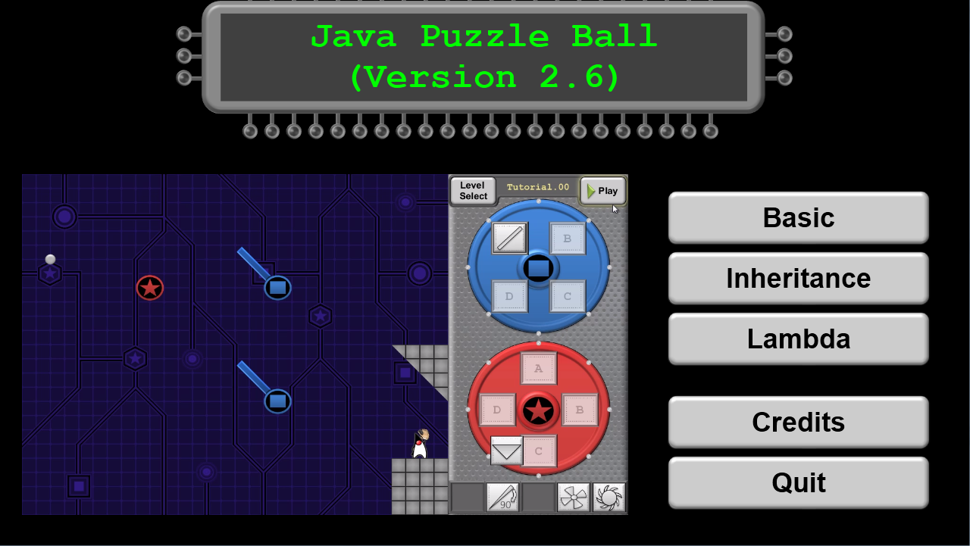
Tips
  You must have Java 8 installed to run the game.
  The game may perform better on your personal machine.
Play this game-mode.
Notes:
Java SE8 Fundamentals 5 - <number>

